Slide 1

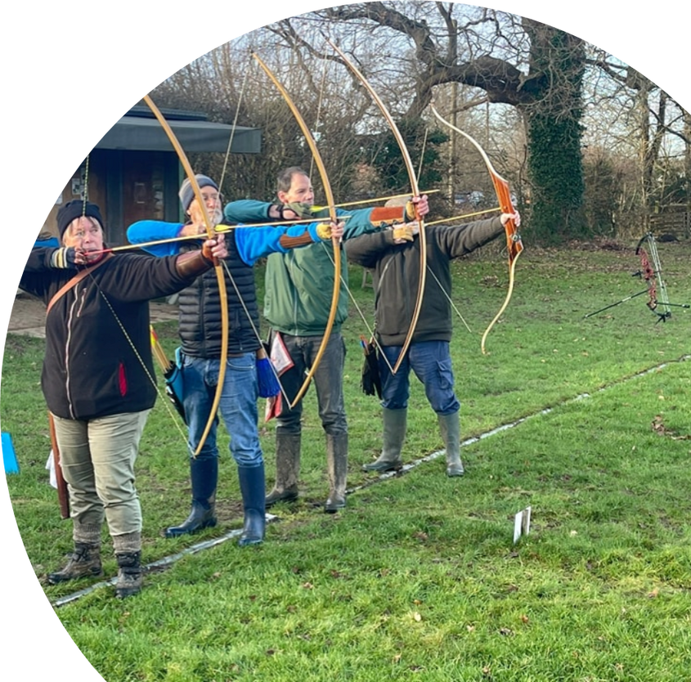
Handicaps & Classifications
Reigate Priory Bowmen

Slide 2

What is a Round?
  A round is a certain number of arrows shot at, typically, more than one specified distance.
  There are two types of round: Metric & Imperial.
  Imperial Rounds (or Archery GB rounds) are shot at imperial distances (yards)
  Metric Rounds (or World Archery rounds) are shot at metric distances (meters)
  You always start a round at the longest distance, ending the round at your shortest distance. For example:
    York: 100yards, 80 yards, and 60 yards
    WA1440 (90m): 90 meters, 70 meters, 50 meters and 30 meters
    (other rounds at shorter distances are available)
  When shooting at the club, the first 6 arrows you shoot will be your “sighters” and so won’t be scoring. These are shot at your longest distance and are your “practice” arrows. You don’t get sighters at your other distances.

Slide 3
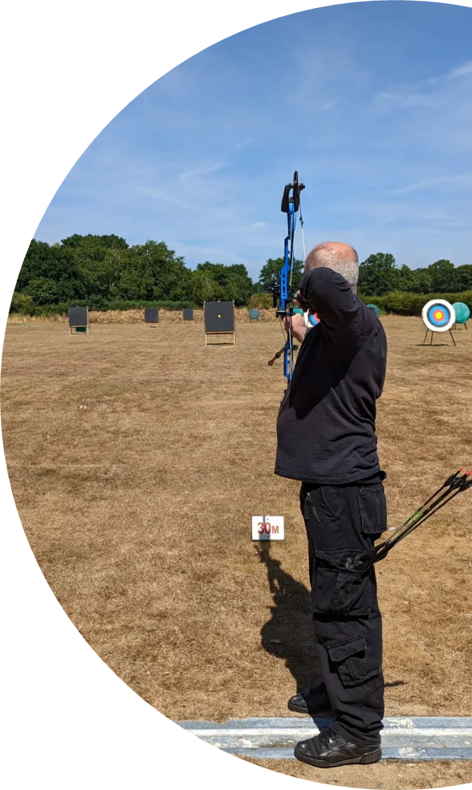
What is a Handicap?
  A handicap is a great way to track how well you’re shooting.
  The average of three scored rounds creates it.
  Each score correlates to a handicap number. Once you know your handicap, you can then use the tables to see if you’ve shot better (or worse) than your handicap.

Slide 4
The Handicap Tables
  Created and owned by Archery GB
  Runs from
  You round the average of your scored rounds down.
  The lower the score, the higher the handicap number.
  You must shoot 3 witnessed, scored rounds to gain a handicap (the average of these three scores will make your starting handicap).
  The Club Records Officer (Bea) will send out an up-to-date table with everyone’s handicap to the membership at the end of every month.
  0 -150

Slide 5

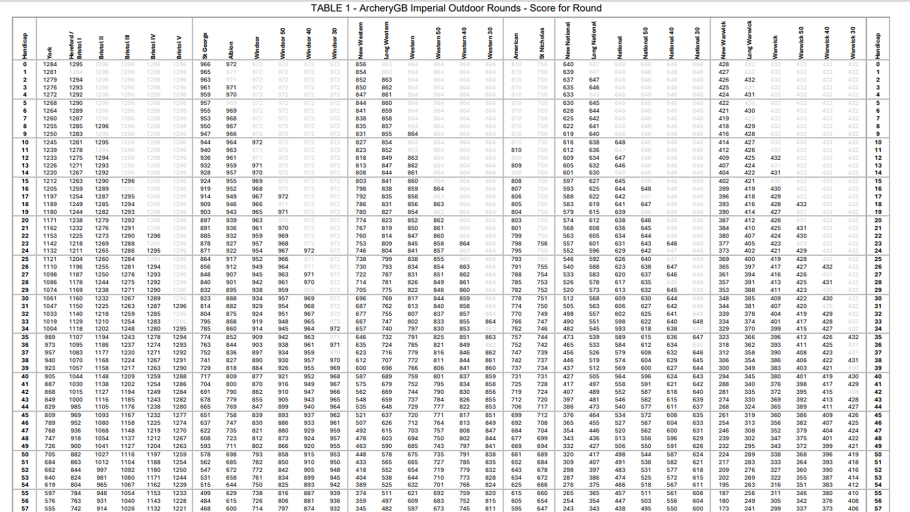

Slide 6


What is a Classification?
A classification determines the “standard” of scores shot by an archer
Archers can obtain classifications based on their score, bowstyle, age category, and gender.

Slide 7

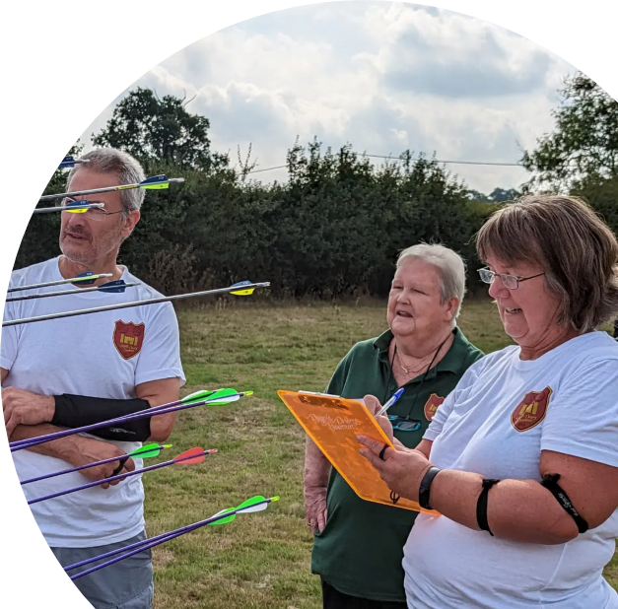
What are the Age Categories?
Men 50+ & Women 50+
Men & Women
Junior Men/Women U21
Junior Men/Women U18
Junior Men/Women U16
Junior Men/Women U15
Junior Men/Women U14
Junior Men/Women U12

Slide 8

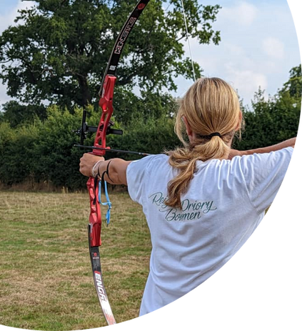
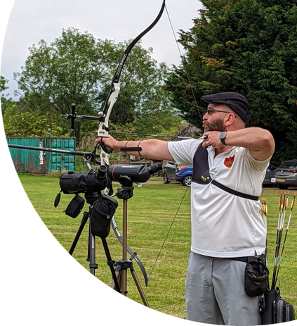
The Archery GB Classification System
Archer Tier | Bowman Tier | Master Bowman Tier
Archer 3rd Class | Bowman 3rd Class | Master Bowman
Archer 2nd Class | Bowman 2nd Class | Grand Master Bowman
Archer 1st Class | Bowman 1st Class | Elite Master Bowman

Slide 9


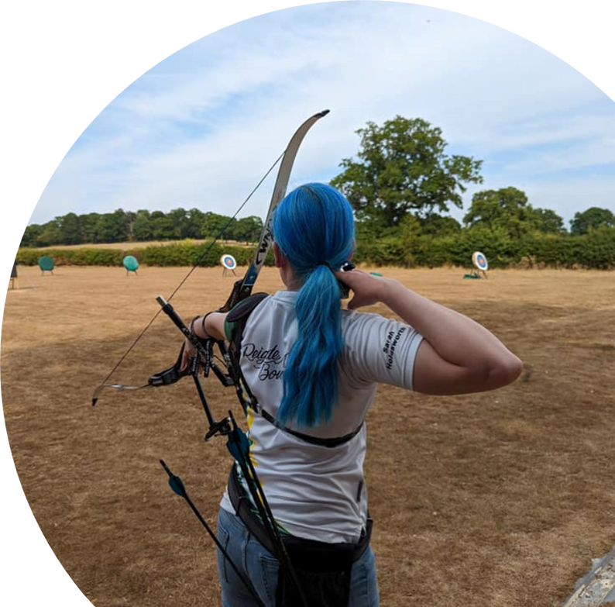
How do I get a Classification?
Archer Tier
Shoot 12 dozen arrows (multiple rounds) to gain an “archer” classification at the Club
Bowman Tier
Shoot 18 dozen arrows (multiple rounds) at an external competition or a scored round on a Saturday, Sunday or Tuesday at the Club
Master Bowman Tier
Shoot 36 dozen arrows (must be age-appropriate 12 dozen rounds, e.g. Women shooting a Hereford) at a Records Status ecent.
Shiny badges and certificates are awarded to archers upon achieving classifications!

Slide 10

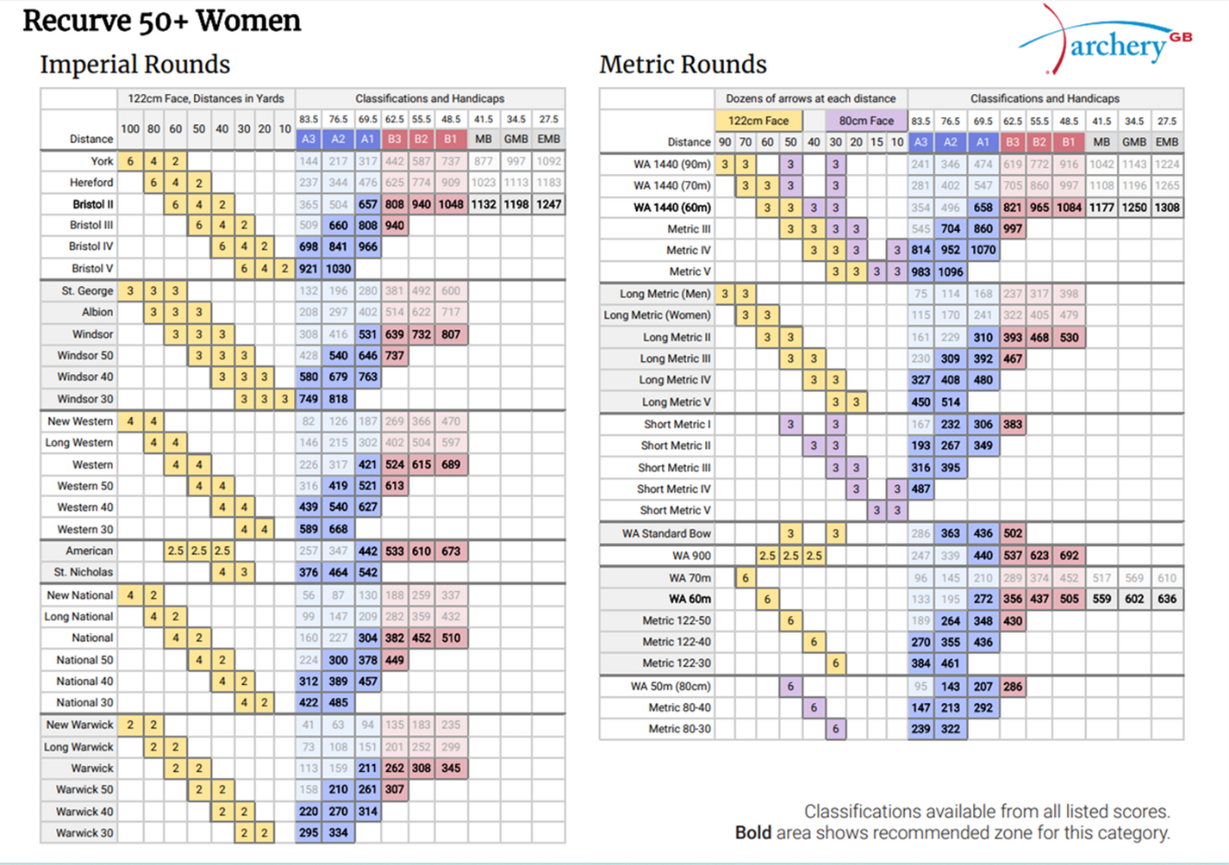

Slide 11

Happy Shooting!

